Slide 1

CRIME DIFFERENCE IN THE WEST MIDLANDS IN AUGUST 2020 VS AUGUST 2021

Slide 2
TOTAL NUMBER OF CRIMES
TOP TYPES OF CRIMES
INTRODUCTION & DATA CLEANING
TABLE
OF
CONTENTS
OUTCOMES & CONCLUSIONS
TOP CRIME OUTCOMES
CRIME LOCATIONS

Slide 3
INTRODUCTION
We chose to look at crimes within the West Midlands over other regions as that is where most of us live and work.
We compared two months, August 2020 and August 2021, to see if the pandemic had any affect on crimes committed.
We predicted that there would be less crimes committed in 2020 due to most of the population either working from home stricter lockdown laws and many people still following government recommendations to stay at home. Also because many businesses and organisations working from home Stricter in 2020

Slide 4
DATA CLEANING
We obtained our data from https://data.police.uk/docs/ - API documentation.
We downloaded 2 CSV files for 2 months that we decided to focus on: August 2020 ("2021-08-west-midlands-street") - 12 columns, 28452 rows August 2021 ("2021-08-west-midlands-street") - 12 columns, 32096 rows
Both data frames have been merged into one, to create a large dataframe with 12 columns and 60548 rows.
We then cleaned the dataframe by removing 7 columns that contained information we didn’t find useful and dropped the row Data Frame volume reduction: Spare colums dropped - final version 7 columns Empty cells dropped - final version 53090 rows

Slide 5
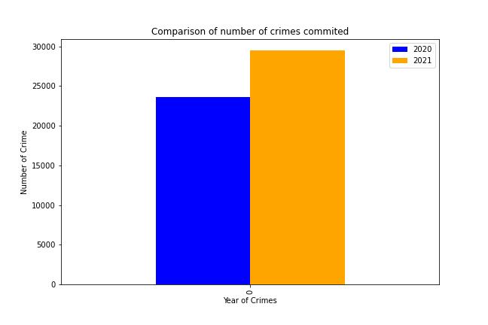
DIFFERENCE IN CRIME NUMBERS
Fully recorded crimes in August 2020: 23644
Fully recorded crimes in August 2021: 29446

Slide 6
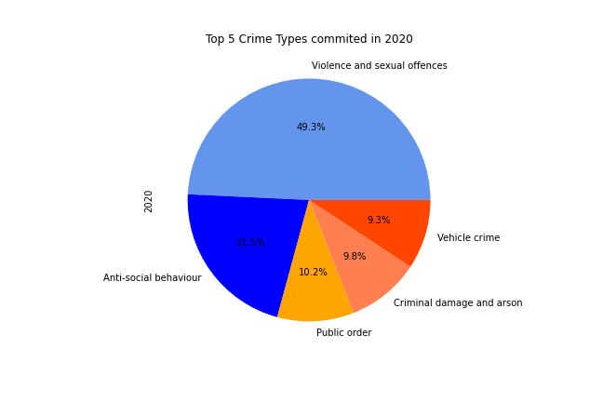
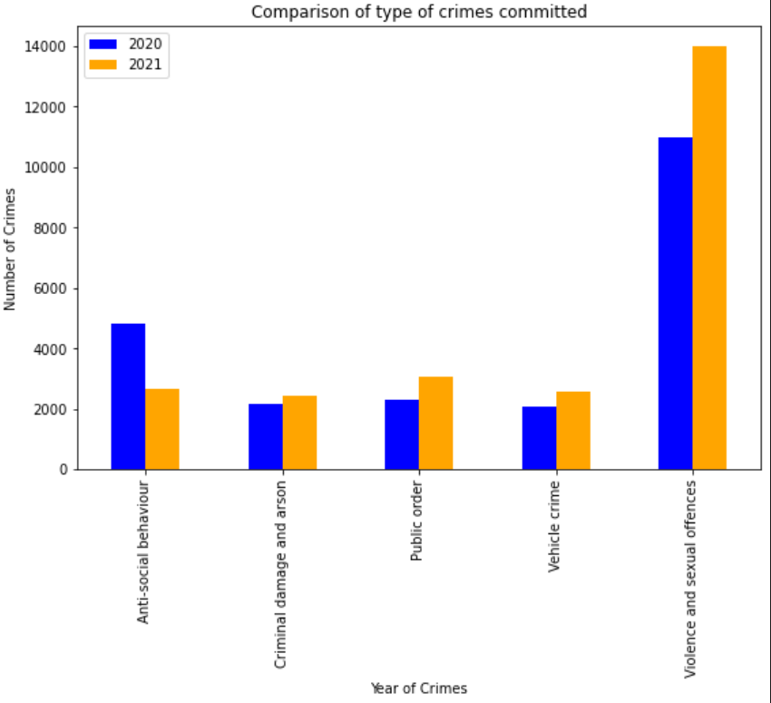
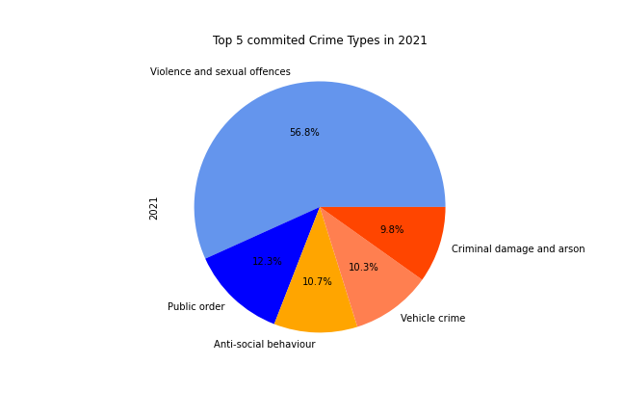
TOP 5 TYPES OF CRIMES COMMITTED

Slide 7
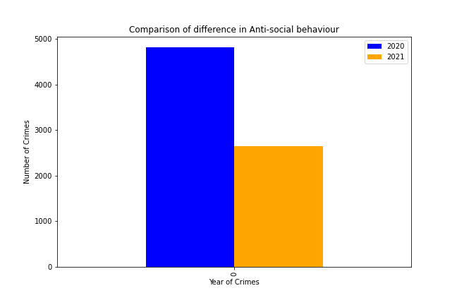
Anti social behaviour and covid

Slide 8
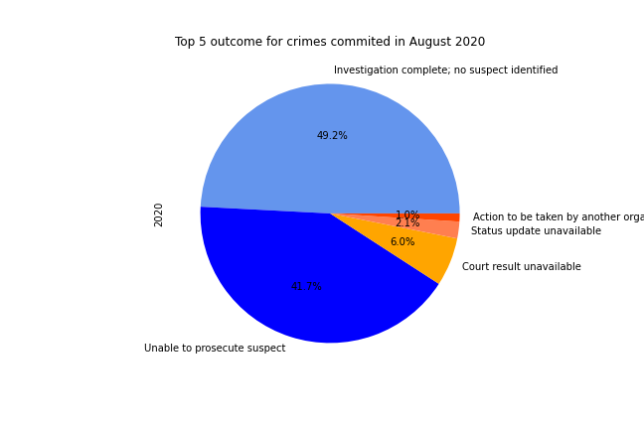
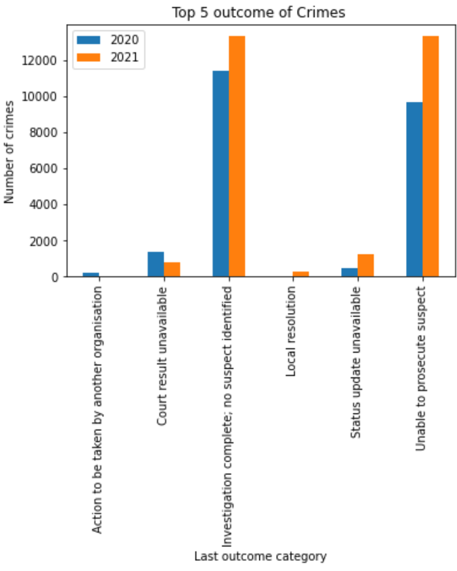
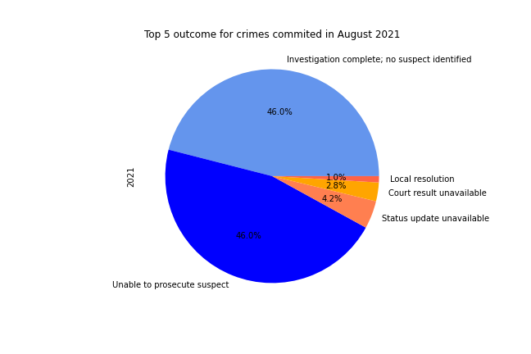
TOP CRIME OUTCOMES

Slide 9
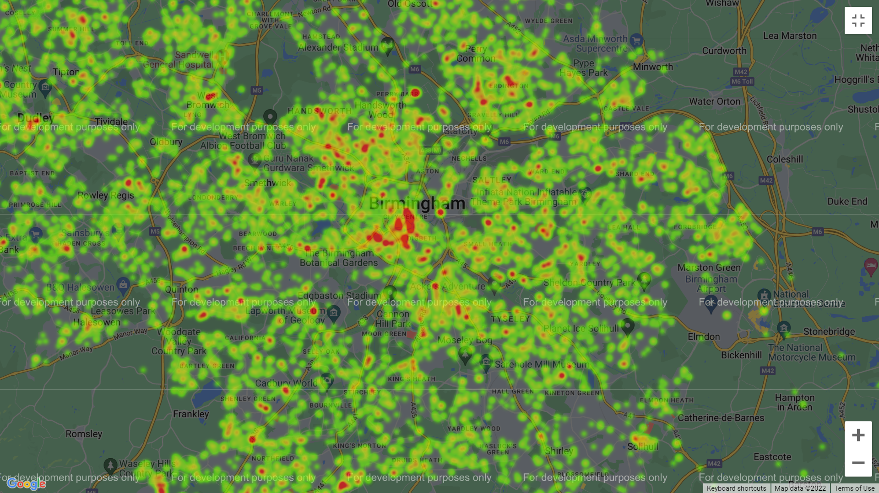
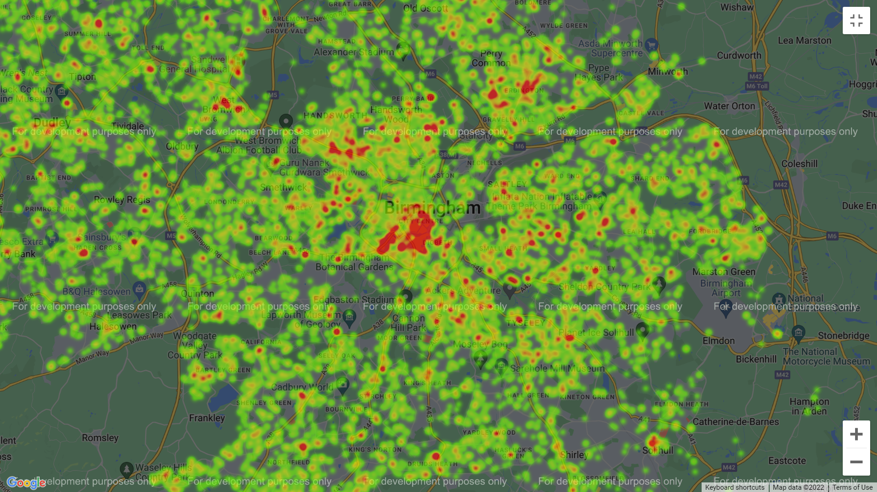
TOP 5 CRIMES IN BIRMINGHAM 2020 & 2021

Slide 10
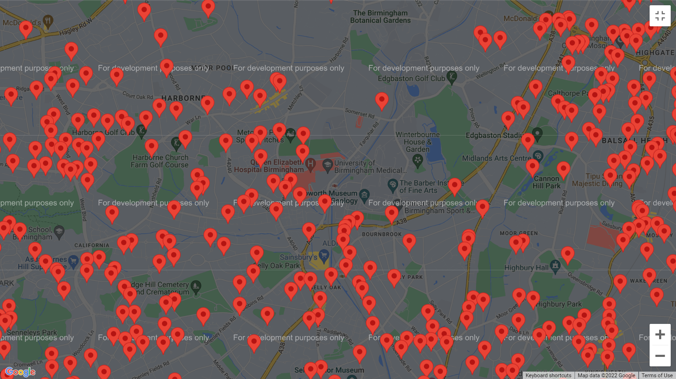
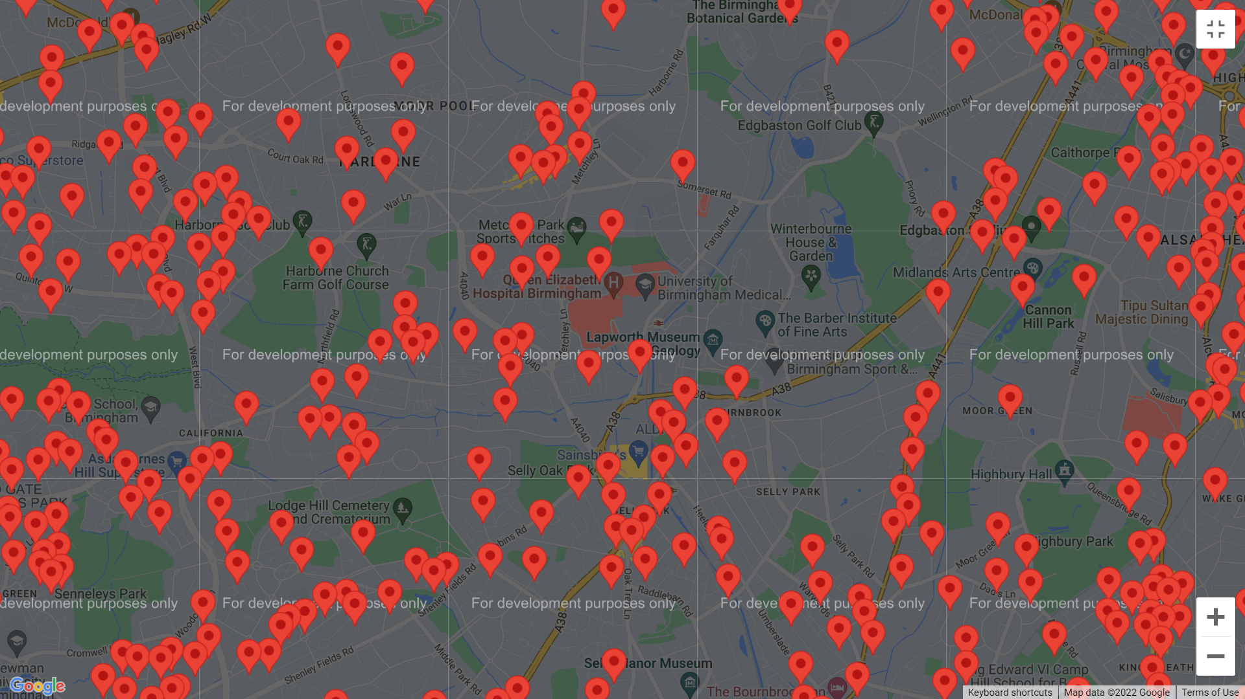
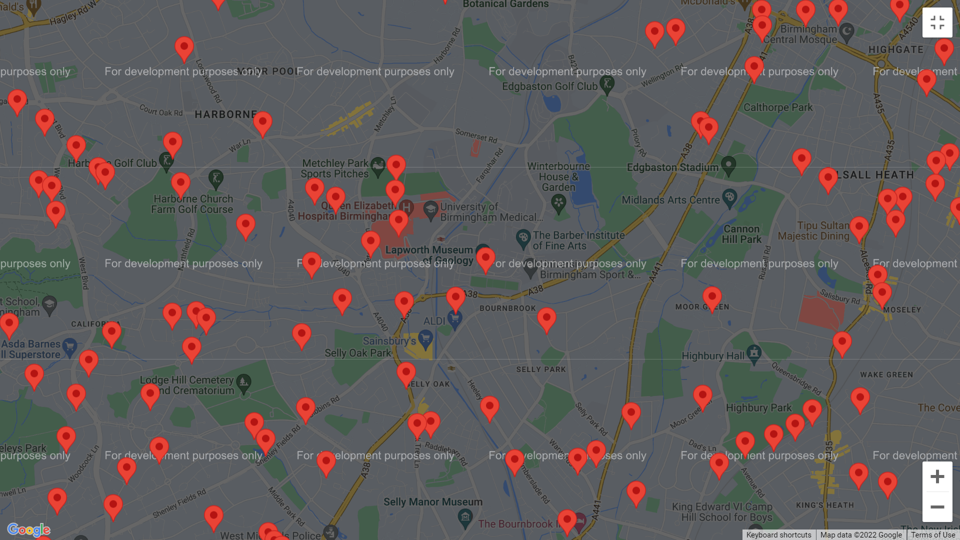
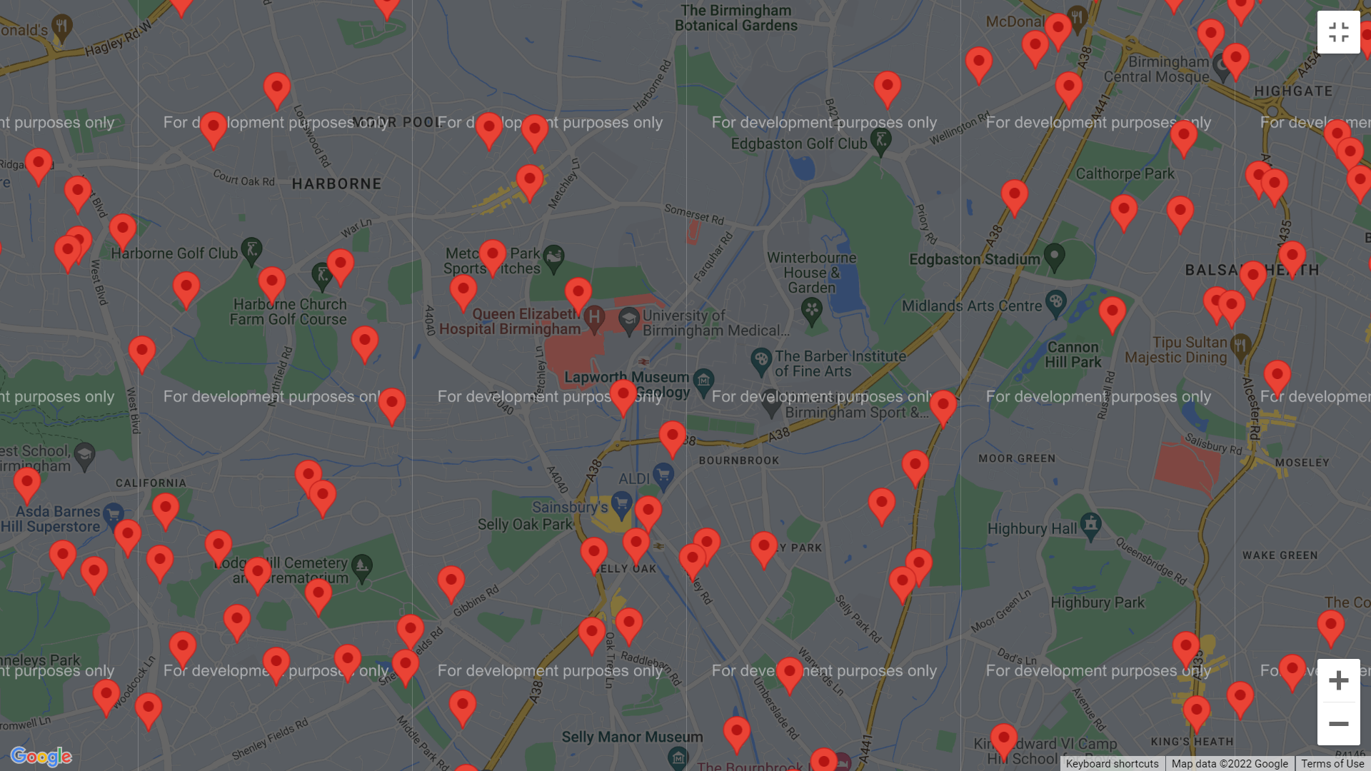
VIOLENCE AND SEXUAL OFFENCES 2020 & 2021 (separate 2 slides)
CRIMINAL DAMAGE AND ARSON 2020 & 2021

Slide 11
OUTCOMES AND CONCLUSIONS
Total number of crimes – slight increase in 2021 most likely because of covid but there could be other reasons
2020 many people were furloughed or made redundant and stayed at home
2021 furlough payment stopped so could resort In more crime
2020 unsure about the pandemic, masks and social distancing
More relaxed in 2021
Eat out to help out scheme may have affected the number of crimes as it was august 2020

